Slide 1
Advancing localization technologies using Stacked Intelligent Metasurfaces
Research Talk | Telecommunication Networks

Slide 2

Use case: Fast tracking of Autonomous Mobile Robots for Smart Factory
Environment:
Dense and dynamic indoor factory floors.
Requirement:
Real-time object tracking for collision avoidance.
[1] Franchi et al, "German Perspective on 6G – Use Cases, Technical Building Blocks and Requirements. Insights by the 6G Platform Germany," Friedrich–Alexander University of Erlangen–Nuremberg (FAU), White Paper, December 2024

Slide 3

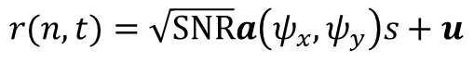
Localization Algorithm
URA
Antenna
$$r(n,t)=\sqrt{SNR}a\left(ψ_{x},ψ_{y}\right)s+u$$
Mobile
Robots
[1] T. J. Cui et al., “Programmable artificial intelligence machine for wave sensing and communications,” Oct. 19, 2020. doi: 10.21203/rs.3.rs-90701/v1.

Slide 4
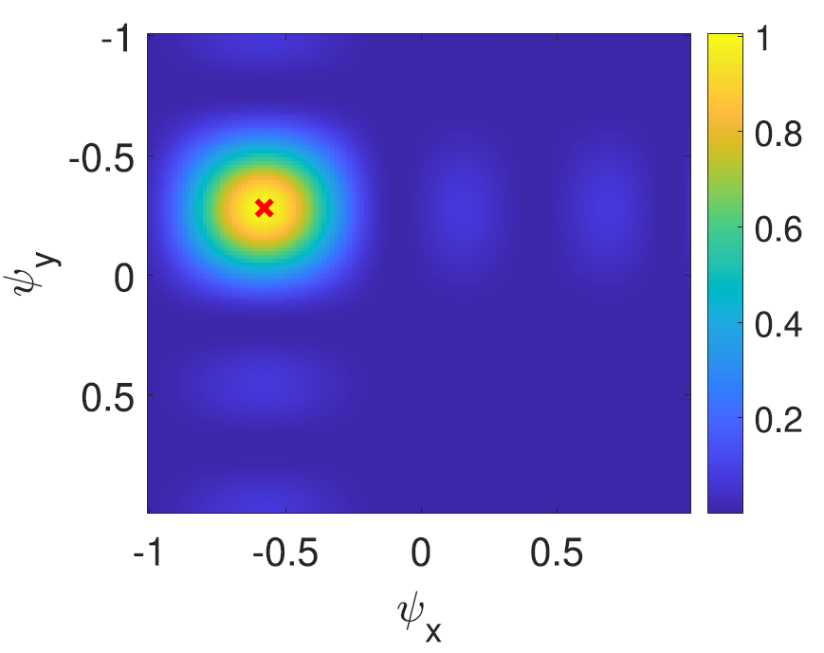
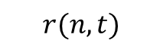
Localization Algorithm
$$r(n,t)$$
Signal Processing
P. Heidenreich, A. M. Zoubir and M. Rubsamen, "Joint 2-D DOA Estimation and Phase Calibration for Uniform Rectangular Arrays," in IEEE Transactions on Signal Processing, vol. 60, no. 9, pp. 4683-4693, Sept. 2012, doi: 10.1109/TSP.2012.2203125.

Slide 5
Localization Algorithm
$$r(n,t)$$
SIM
2D-Discrete Fourier Transform
Signal Processing
J. An et al., "Two-Dimensional Direction-of-Arrival Estimation Using Stacked Intelligent Metasurfaces," in IEEE Journal on Selected Areas in Communications, vol. 42, no. 10, pp. 2786-2802, Oct. 2024.

Slide 6
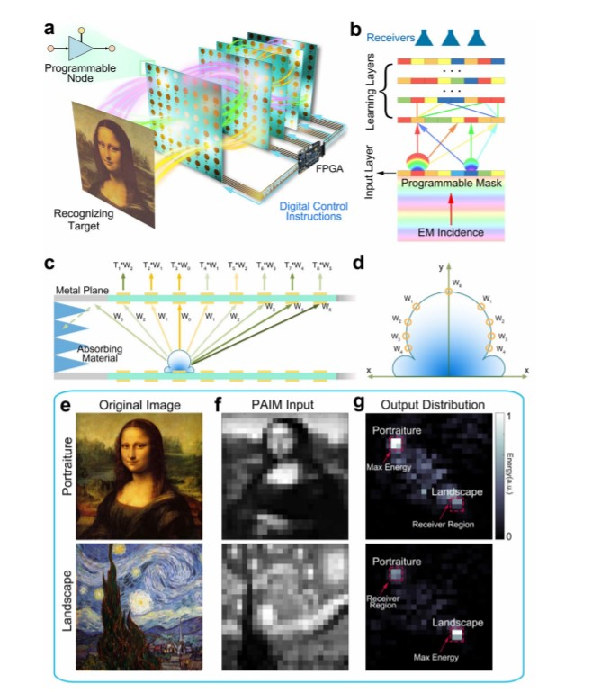
Stacked Intelligent Metasurfaces
[1] T. J. Cui et al., “Programmable artificial intelligence machine for wave sensing and communications,” Oct. 19, 2020. doi: 10.21203/rs.3.rs-90701/v1.

Slide 7
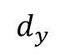

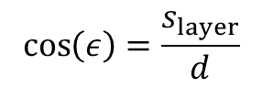
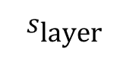
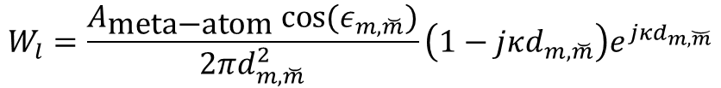
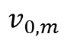
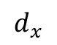



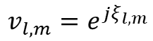
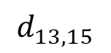
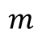
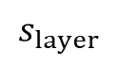
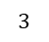
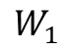
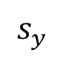
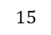

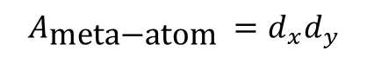

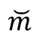
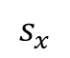

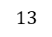
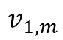
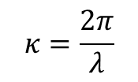
SIM modeling
Layer 1
$$W_{1}$$
Input
Layer
$$v_{1,m}$$
$$W_{0}$$
Transmission coefficient:
$$d$$
$$v_{0,m}$$
$$v_{l,m}=e^{jξ_{l,m}}$$
$$s_{\text{layer} }$$
EM-wave propagation:
$$W_{l}=\frac{A_{\text{meta}\text{−}\text{atom} }cos⁡(ε_{m,\breve{m}})}{2πd_{m,\breve{m}}^{2}}\left(1−jκd_{m,\breve{m}}\right)e^{jκd_{m,\breve{m}}}$$
$$s_{y}$$
$$s_{x}$$
$$d_{y}$$
$$A_{\text{meta}\text{−}\text{atom} }=d_{x}d_{y}$$
$$15$$
$$4$$
$$d_{x}$$
$$m$$
$$d_{13,15}$$
$$3$$
$$\cos\left(ε\right)=\frac{s_{layer}}{d}$$
$$ε$$
$$2$$
$$s_{layer}$$
$$κ=\frac{2π}{λ}$$
$$13$$
$$5$$
$$1$$
$$\breve{m}$$

Slide 8
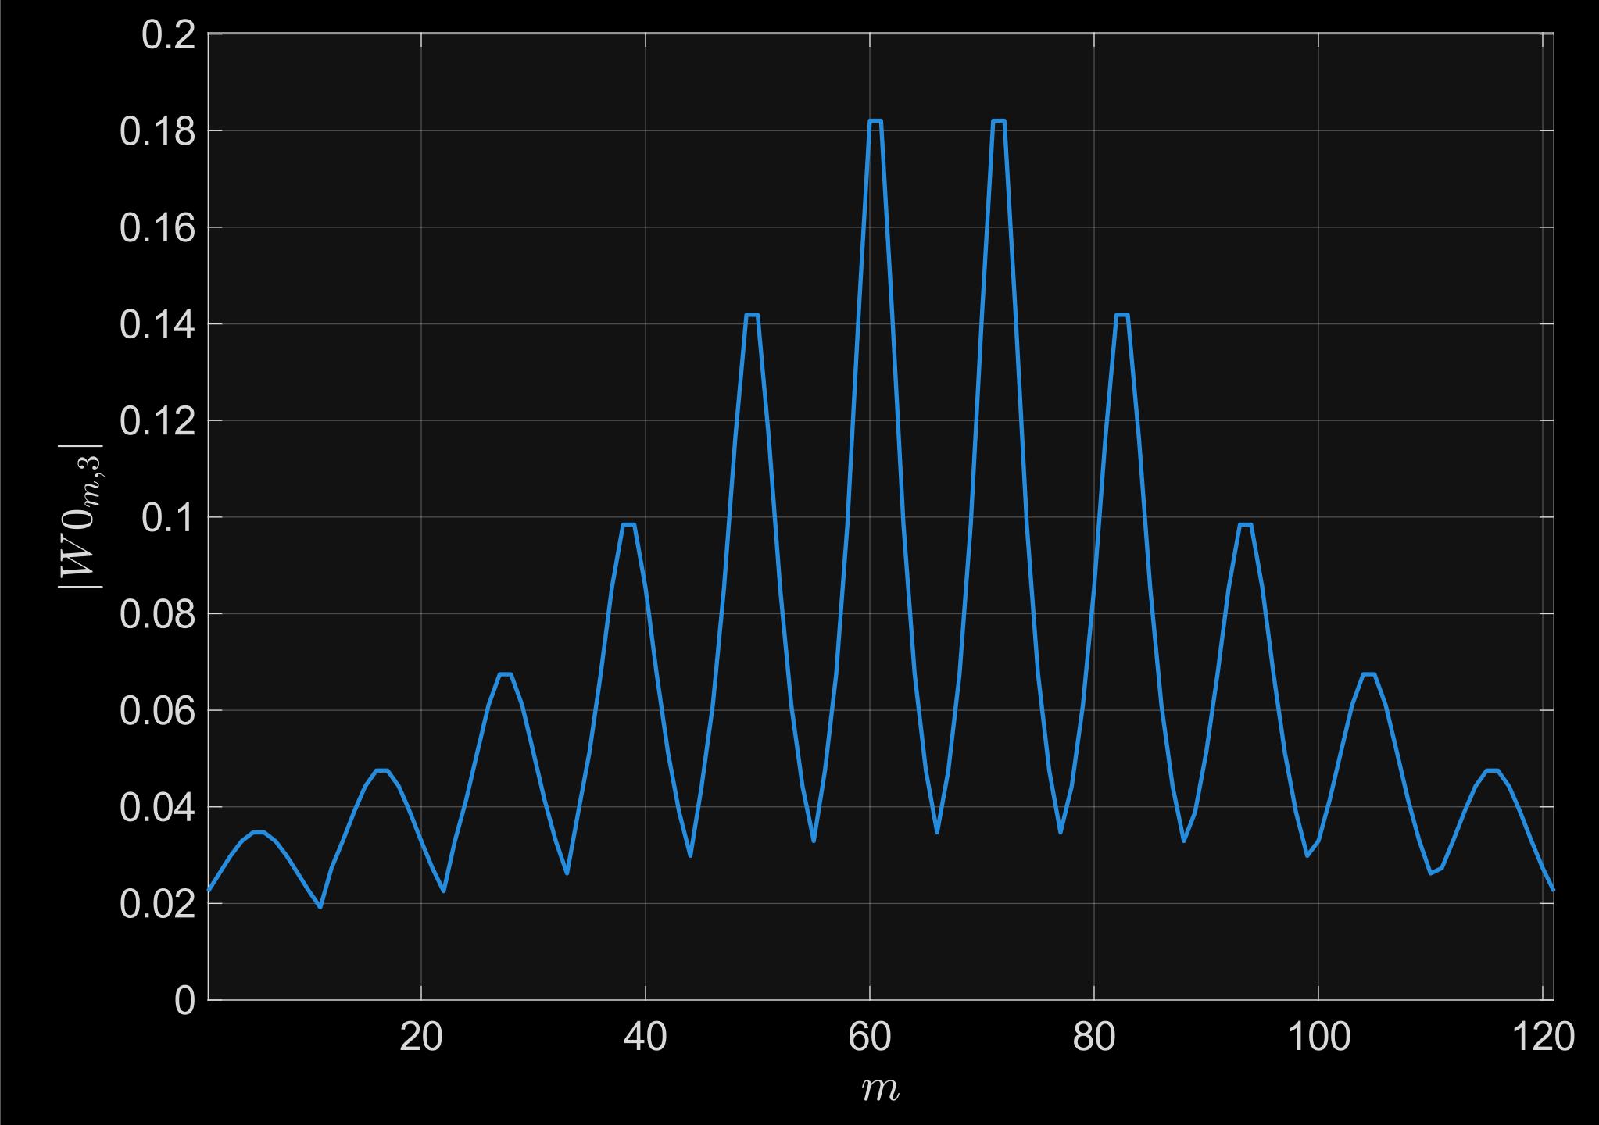
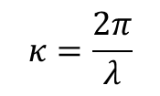


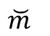


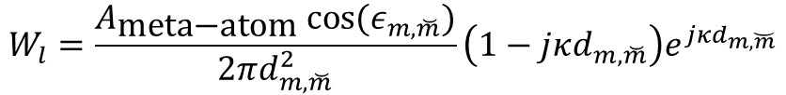
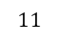
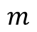
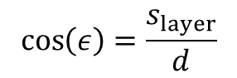


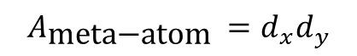

SIM modeling
Layer 1
$$11$$
Input Layer
$$⋮$$
EM-wave propagation:
$$2$$
$$3$$
$$1$$
$$2$$
$$W_{l}=\frac{A_{\text{meta}\text{−}\text{atom} }cos⁡(ε_{m,\breve{m}})}{2πd_{m,\breve{m}}^{2}}\left(1−jκd_{m,\breve{m}}\right)e^{jκd_{m,\breve{m}}}$$
$$\breve{m}$$
$$⋅⋅⋅$$
$$1$$
$$m$$
$$A_{\text{meta}\text{−}\text{atom} }=d_{x}d_{y}$$
$$\cos\left(ε\right)=\frac{s_{layer}}{d}$$
$$κ=\frac{2π}{λ}$$

Slide 9
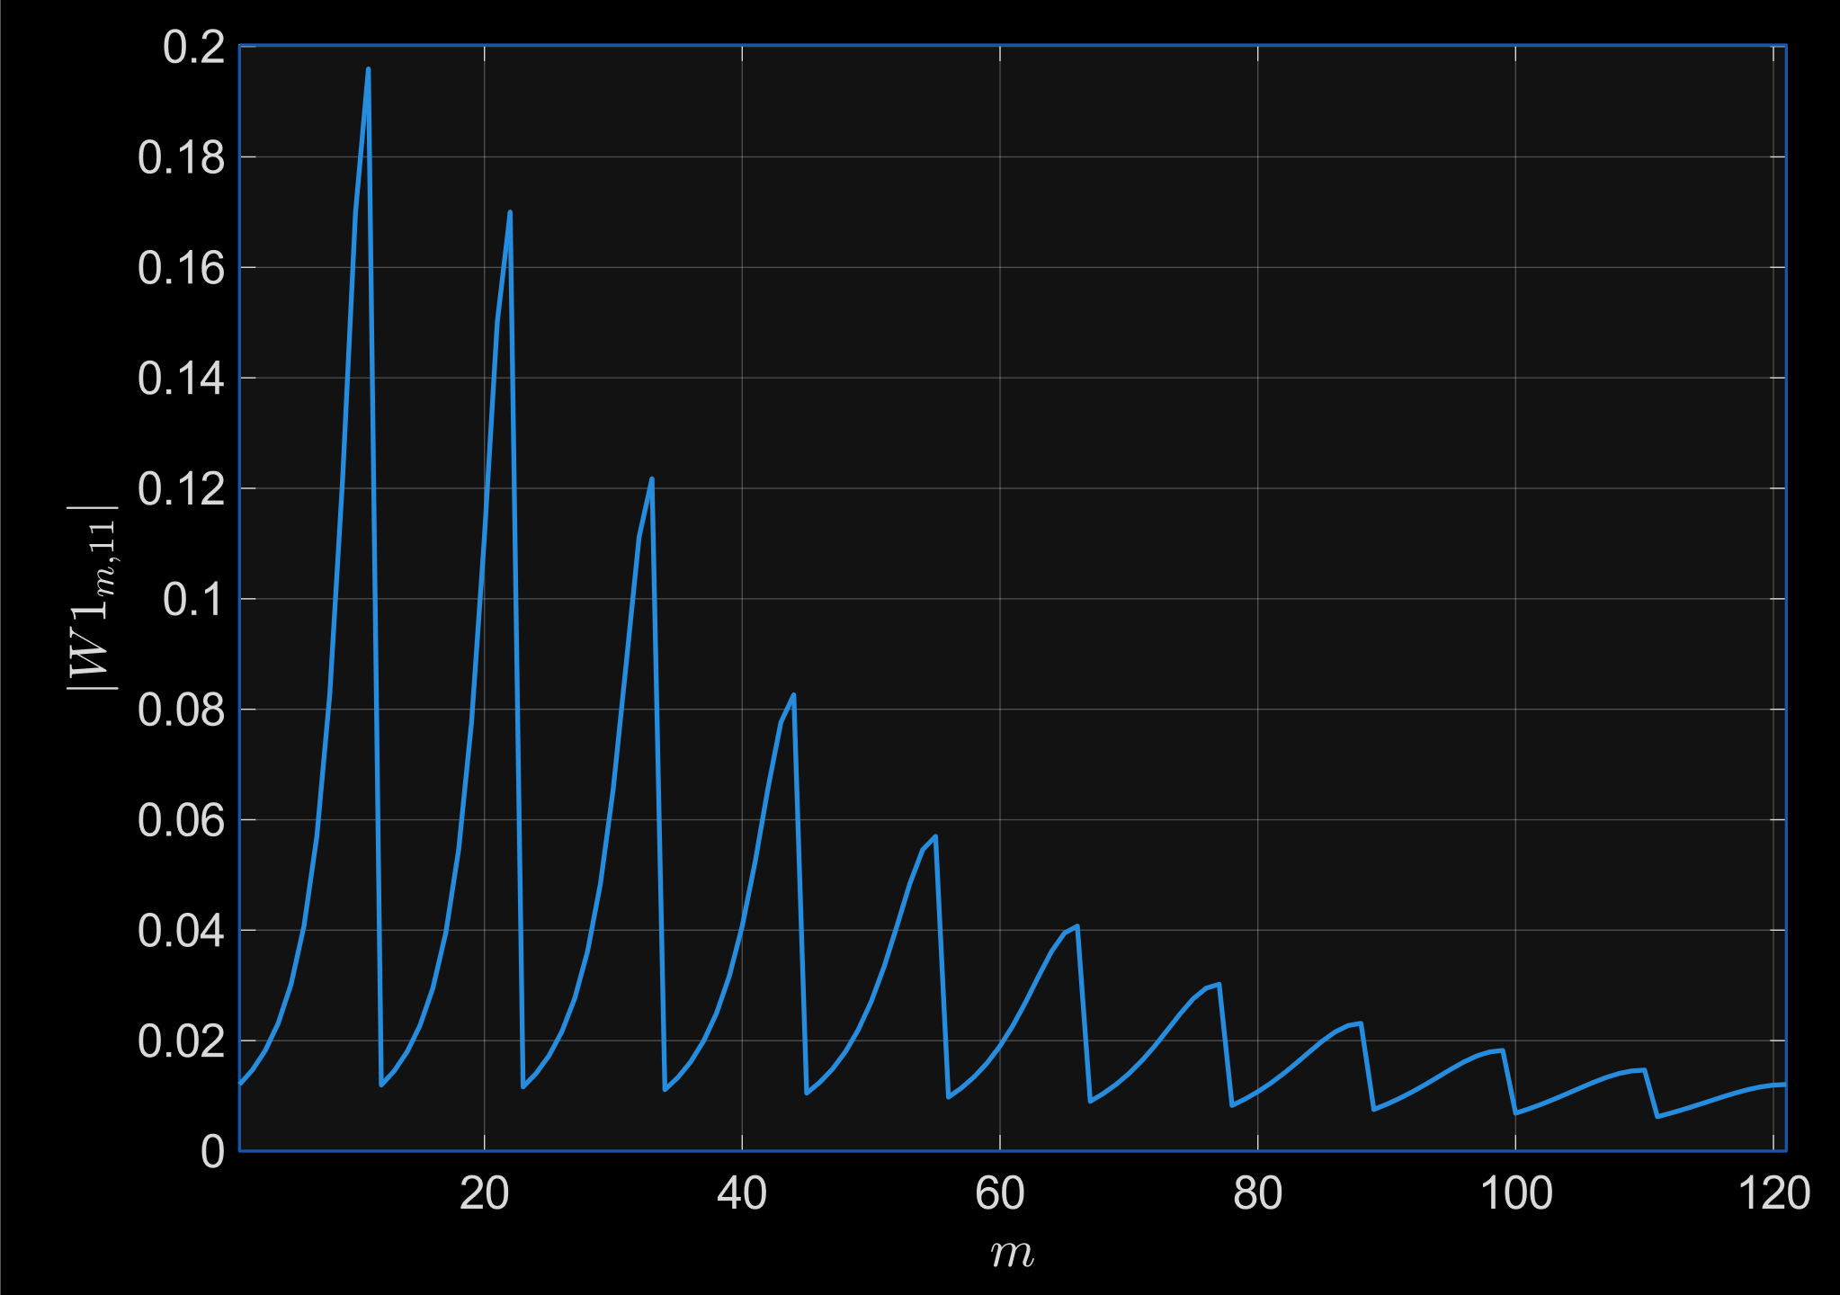


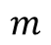
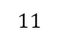

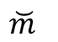

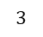

SIM modeling
$$11$$
$$⋮$$
$$m$$
$$11$$
$$⋮$$
$$\breve{m}$$
$$3$$
EM-wave propagation:
$$⋅⋅⋅$$
$$2$$
Layer 2
$$W_{l}=\frac{A_{\text{meta}\text{−}\text{atom} }cos⁡(ε_{m,\breve{m}})}{2πd_{m,\breve{m}}^{2}}\left(1−jκd_{m,\breve{m}}\right)e^{jκd_{m,\breve{m}}}$$
$$⋅⋅⋅$$
$$1$$
Layer 1
$$A_{\text{meta}\text{−}\text{atom} }=d_{x}d_{y}$$
$$\cos\left(ε\right)=\frac{s_{layer}}{d}$$
$$κ=\frac{2π}{λ}$$

Slide 10
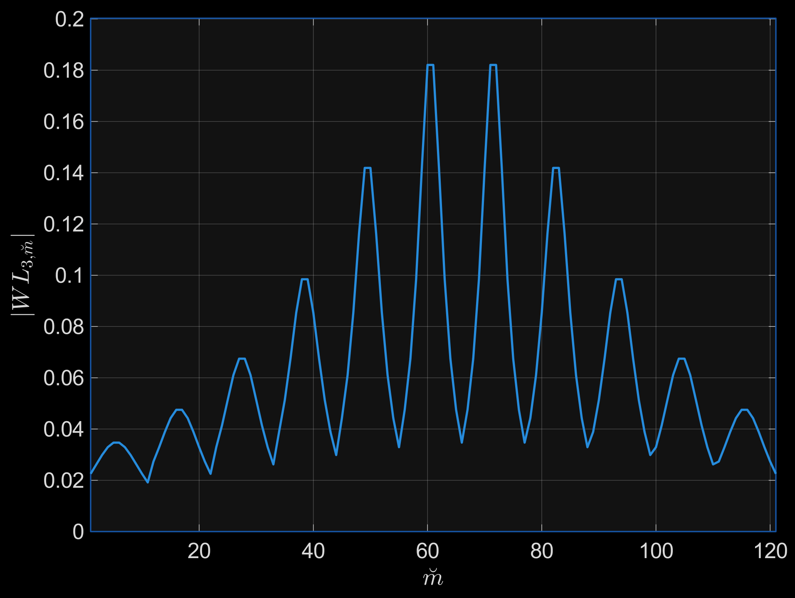


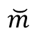


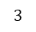
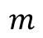
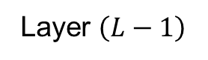
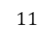

SIM modeling
Layer $\left(L−1\right)$
Output Layer
$$11$$
$$⋮$$
EM-wave propagation:
$$4$$
$$2$$
$$1$$
$$2$$
$$W_{l}=\frac{A_{\text{meta}\text{−}\text{atom} }cos⁡(ε_{m,\breve{m}})}{2πd_{m,\breve{m}}^{2}}\left(1−jκd_{m,\breve{m}}\right)e^{jκd_{m,\breve{m}}}$$
$$3$$
$$⋅⋅⋅$$
$$1$$
$$m$$
$$\breve{m}$$
$$A_{\text{meta}\text{−}\text{atom} }=d_{x}d_{y}$$
$$\cos\left(ε\right)=\frac{s_{layer}}{d}$$
$$κ=\frac{2π}{λ}$$

Slide 11

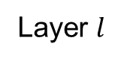
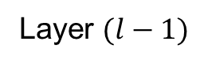
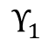
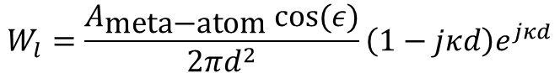
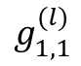
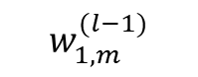
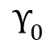









SIM modeling
$$G_{l}=Υ_{l}W_{l−1}={\left[\begin{matrix}e^{jξ_{l,1}} & 0 \\ \begin{matrix}0 \\ ⋮ \\ 0\end{matrix} & \begin{matrix}e^{jξ_{l,2}} \\ ⋮ \\ 0\end{matrix}\end{matrix} \begin{matrix}⋯ & 0 \\ \begin{matrix}⋯ \\ ⋮ \\ 0\end{matrix} & \begin{matrix}0 \\ ⋮ \\ e^{jξ_{l,M}}\end{matrix}\end{matrix}\right]}_{M×M}{\left[\begin{matrix}w_{1,1}^{(l−1)} & w_{1,2}^{(l−1)} & \begin{matrix}⋯ & w_{1,M}^{(l−1)}\end{matrix} \\ w_{2,1}^{(l−1)} & w_{2,2}^{(l−1)} & \begin{matrix}⋯ & w_{2,M}^{(l−1)}\end{matrix} \\ \begin{matrix}⋮ \\ w_{M,1}^{(l−1)}\end{matrix} & \begin{matrix}⋮ \\ w_{M,2}^{(l−1)}\end{matrix} & \begin{matrix}\begin{matrix}⋯ & ⋮ \end{matrix} \\ \begin{matrix}⋯ & w_{M,M}^{(l−1)}\end{matrix}\end{matrix}\end{matrix}\right]}_{M×M}$$
Layer 1
$$W_{1}$$
Input
Layer
$$Υ_{1}$$
$$W_{0}$$
$$d$$
$$Υ_{0}$$
$$s_{\text{layer} }$$
$$g_{1,1}^{(l)}=e^{jξ_{l,1}}\sum_{m=1}^{M}{w_{1,m}^{(l−1)}}$$
Layer $(l−1)$
$$w_{1,M }^{(l−1)}$$
$$w_{1,M_{x}}^{(l−1)}$$
Layer $l$
$$g_{1,1}^{(l)}$$
$$w_{1,1}^{(l−1)}$$
$$Υ_{l,m}=e^{jξ_{l,m}}$$
$$w_{1,m }^{(l−1)}$$
$$W_{l}=\frac{A_{\text{meta}\text{−}\text{atom} }cos⁡(ε)}{2πd^{2}}\left(1−jκd\right)e^{jκd}$$

Slide 12









SIM approximator
$$N=2×2$$
$$M=11×11$$
$$F={[f_{n_{ψ},n }]}_{ }=\left[e^{−j2π\frac{(n_{ψ_{x}}−1)(n_{x}−1)}{N_{x}}}e^{−j2π\frac{(n_{ψ_{y}}−1)(n_{y}−1)}{N_{y}}}\right]$$
(1)
2D-DFT
$$ℒ={\left\|βG−F\right\|}^{2}$$
(2)
SIM model
$$G=W_{L}Υ_{L}⋯Υ_{l}W_{l}⋯Υ_{0}W_{0}$$
(3)
$$Υ_{l}=[Υ_{l,m}]=\left[e^{jξ_{l,m}}\right]$$
(4)
$$ξ_{l,m}^{(k+1)}=ξ_{l,m}^{(k)}−η^{(k)}∇_{ξ_{l,m}}ℒ$$
(5)
$$η^{(k)}=η^{(k−1)}ζ$$
(6)

Slide 13






















2D-DFT Scheme
$$r(n,t)$$
SIM
$$n_{x}$$
$$9$$
$$3$$
$$2$$
$$Υ_{0}(t)$$
$$a\left(ψ_{x},ψ_{y}\right)s$$
$$4$$
$$1$$
$$n$$
$$n_{y}$$
$$G\sim 2D−Fourier Kernel$$
$$f_{n_{ψ},n }=e^{−j2π\frac{(n_{ψ_{x}}−1)(n_{x}−1)}{N_{x}}}e^{−j2π\frac{(n_{ψ_{y}}−1)(n_{y}−1)}{N_{y}}}$$
$n$: spatial dimension
$n_{\text{ψ}}$: angular dimension
$$n,n_{\text{ψ}}∈\left\{1,2,⋯,N_{x}N_{y}\right\}$$
2
on-grid DOA
spatial freq.
offset
1
$$T_{upd}$$
$n_{y}=\left\lceil \frac{n}{N_{x}}\right\rceil$, $y$-component of the spatial dimension
$$r(n,t)=\sqrt{SNR}GΥ_{0}\left(t\right)a\left(ψ_{x},ψ_{y}\right)s+u$$
$$Υ_{0}(t_{0})$$
$$Υ_{0}(t_{1})$$
$$⋯$$
$$Υ_{0}(t_{0})$$
$n_{x}=n−(n_{y}−1)N_{x}$, $x$-component of the spatial dimension
$$t$$
$$\left[\hat{φ},\hat{θ}\right]=f\left(\underset{n,t}{arg max}{r(n,t)}\right)$$
J. An et al., "Two-Dimensional Direction-of-Arrival Estimation Using Stacked Intelligent Metasurfaces," in IEEE Journal on Selected Areas in Communications, vol. 42, no. 10, pp. 2786-2802, Oct. 2024.

Slide 14














Localization Algorithm
$$r(n,t)=\sqrt{SNR}GΥ_{0}\left(t\right)a\left(ψ_{x},ψ_{y}\right)s+u$$
(1)
SIM
$$a\left(ψ_{x},ψ_{y}\right)={\left[e^{jψ_{x}(n_{x}−1)}\right]⊗\left[e^{jψ_{y}(n_{y}−1)}\right]}_{N×1}$$
(2)
Step
1
$$Υ_{0}(t)$$
$$Υ_{0}\left(t\right)=diag\left(e^{−j2π\frac{(t_{x}−1)(n_{x}−1)}{N_{x}T_{x}}}e^{−j2π\frac{(t_{y}−1)(n_{y}−1)}{N_{y}T_{y}}}\right)$$
(3)
Step
2
$$G={\left[f_{n_{ψ},n }\right]}_{N×N}=\left[e^{−j2π\frac{(n_{ψ_{x}}−1)(n_{x}−1)}{N_{x}}}e^{−j2π\frac{(n_{ψ_{y}}−1)(n_{y}−1)}{N_{y}}}\right]$$
$$T_{upd}$$
(4)
$$Υ_{0}(t_{0})$$
$$Υ_{0}(t_{1})$$
$$Υ_{0}(t_{2})$$
$$⋯$$
$$Υ_{0}(t_{0})$$
$${𝕴\left(t\right)}_{N×N}=\left[e^{−j2π\frac{(n_{ψ_{x}}+\frac{t_{x}}{T_{x}}−1−\frac{1}{T_{x}})(n_{x}−1)}{N_{x}}}e^{−j2π\frac{(n_{ψ_{y}}+\frac{t_{y}}{T_{y}}−1−\frac{1}{T_{y}})(n_{y}−1)}{N_{y}}}\right]$$
(5)
$$t$$
$$\left[\hat{φ},\hat{θ}\right]=f\left(\underset{n,t}{arg max}{r(n,t)}\right)$$
(6)
J. An et al., "Two-Dimensional Direction-of-Arrival Estimation Using Stacked Intelligent Metasurfaces," in IEEE Journal on Selected Areas in Communications, vol. 42, no. 10, pp. 2786-2802, Oct. 2024.

Slide 15











2D-DFT Scheme
$${r\left(n,t\right)}_{N×1}=\sqrt{SNR} {𝕴\left(t\right)}_{N×N}{a\left(ψ_{x},ψ_{y}\right)}_{N×1}s+u$$
(1)
$$n_{x}$$
$$a\left(ψ_{x},ψ_{y}\right)={\left[e^{jψ_{x}(n_{x}−1)}\right]⊗\left[e^{jψ_{y}(n_{y}−1)}\right]}_{N×1}$$
(2)
$$9$$
$$3$$
$${𝕴\left(t\right)}_{N×N}=\left[e^{−j2π\frac{(n_{ψ_{x}}+\frac{t_{x}}{T_{x}}−1−\frac{1}{T_{x}})(n_{x}−1)}{N_{x}}}e^{−j2π\frac{(n_{ψ_{y}}+\frac{t_{y}}{T_{y}}−1−\frac{1}{T_{y}})(n_{y}−1)}{N_{y}}}\right]$$
$$2$$
(3)
$$4$$
$$1$$
$$n$$
$$n_{y}$$
$$T_{upd}$$
$$Υ_{0}(t_{0})$$
$$Υ_{0}(t_{1})$$
$$⋯$$
$$Υ_{0}(t_{0})$$
$$t$$
$$ψ_{x}=\frac{2πn_{ψ_{x}}}{N_{x}}$$
(4)
$$ψ_{y}=\frac{2πn_{ψ_{x}}}{N_{y}}$$
(5)
J. An et al., "Two-Dimensional Direction-of-Arrival Estimation Using Stacked Intelligent Metasurfaces," in IEEE Journal on Selected Areas in Communications, vol. 42, no. 10, pp. 2786-2802, Oct. 2024.

Slide 16






2D-DFT Scheme
Snapshot $1$
$$ψ_{y}$$
SIM
$$Υ_{0}(t)$$
$$ψ_{x}$$
$$T_{upd}$$
$$Υ_{0}(t_{0})$$
$$⋯$$
$$t$$

Slide 17





2D-DFT Scheme
Snapshot $1$
Snapshot $n_{1}$
$$ψ_{y}$$
$$ψ_{y}$$
SIM
$$Υ_{0}(t)$$
$$ψ_{x}$$
$$ψ_{x}$$
$$T_{upd}$$
$$Υ_{0}(t_{0})$$
$$⋯$$
$$Υ_{0}(t_{n1})$$
$$t$$

Slide 18












2D-DFT Scheme
Snapshot $1$
Snapshot $n_{1}$
$$ψ_{y}$$
$$ψ_{y}$$
SIM
$$Υ_{0}(t)$$
$$ψ_{x}$$
$$ψ_{x}$$
$$T_{upd}$$
Snapshot $n_{2}$
$$ψ_{y}$$
$$Υ_{0}(t_{0})$$
$$⋯$$
$$Υ_{0}(t_{n1})$$
$$⋯$$
$$Υ_{0}(t_{n2})$$
$$t$$
J. An et al., "Two-Dimensional Direction-of-Arrival Estimation Using Stacked Intelligent Metasurfaces," in IEEE Journal on Selected Areas in Communications, vol. 42, no. 10, pp. 2786-2802, Oct. 2024.
$$ψ_{x}$$

Slide 19
2D-DFT Scheme
Snapshot $1$
Snapshot $n_{1}$
$$ψ_{y}$$
$$ψ_{y}$$
SIM
$$Υ_{0}(t)$$
$$ψ_{x}$$
$$ψ_{x}$$
RL
Snapshot $n_{2}$
$$ψ_{y}$$
$$Υ_{0}(t_{0})$$
$$Υ_{0}(t_{n2})$$
$$t$$
J. An et al., "Two-Dimensional Direction-of-Arrival Estimation Using Stacked Intelligent Metasurfaces," in IEEE Journal on Selected Areas in Communications, vol. 42, no. 10, pp. 2786-2802, Oct. 2024.
$$ψ_{x}$$

Slide 20








Fast-localization Algorithm
SIM 2
Neural
Network
SIM 1
$$𝕴\left(t\right)$$
$$Q_{1}$$
$$⋯$$
$$Q_{n}$$
$$Υ_{i}(ξ_{i,t})$$
$$Υ_{0}(t_{0})$$
$$Υ_{0}(t_{n2})$$
Q-Table
$$t$$

Slide 21





Fast-localization Algorithm
SIM 2
Neural
Network
SIM 1
$$𝕴\left(t\right)$$
$$Q_{i}$$
$$Υ_{i}(ξ_{i,t})$$
Q-Table
$$Υ_{0}(t_{0})$$
$$Υ_{0}(t_{n2})$$
$$t$$

Slide 22
Advancing localization technologies using Stacked Intelligent Metasurfaces
Research Talk | Telecommunication Networks

Slide 23


Fast-tracking Algorithm
SIM 2
Neural
Network
SIM 1
$$𝕴\left(t\right)$$
$$Q_{1}$$
$$⋯$$
$$Q_{n}$$
Mobile
Users
$$Υ_{i}(ξ_{i,t})$$
$$Υ_{0}(t_{0})$$
$$Υ_{0}(t_{n2})$$
Q-Table
$$t$$

Slide 24


DoA methods
SIM
Beamformers
$y\left(t\right)=w^{H}x\left(t\right)$
Spatial: $P\left(φ\right)=\frac{1}{N}\sum{{\left|y(t)\right|}^{2}}$
Barlett:$w=\frac{a(φ)}{\sqrt{a^{H}(φ)a(φ)}}$
Capon: $w=\frac{R^{−1}a(φ)}{a^{H}(φ)R^{−1}a(φ) }$
Subspace-based methods
MUSIC: $P(φ)=\frac{a^{H}(φ) a(φ)}{a^{H}\left(φ\right)Π a(φ)}$
ESPRIT: $φ=arcsin\left(\frac{λθ}{2πd}\right)$
[1] H. Krim and M. Viberg, “Two decades of array signal processing research: the parametric approach,” IEEE Signal Processing Magazine, vol. 13, no. 4, pp. 67–94, Jul. 1996, doi: 10.1109/79.526899.
[2] S. A. (Reza) Zekavat, “An Introduction to Direction-of-Arrival Estimation Techniques,” in Handbook of Position Location, John Wiley & Sons, Ltd, 2018, pp. 303–341. doi: 10.1002/9781119434610.ch9.

Slide 25
Fast-tracking Algorithm
SIM
Mobile
User
$$T_{upd}$$
$$Υ_{0}(t_{0})$$
$$Υ_{0}(t_{1})$$
$$⋯$$
$$Υ_{0}(t_{0})$$
$$t$$
J. An et al., "Two-Dimensional Direction-of-Arrival Estimation Using Stacked Intelligent Metasurfaces," in IEEE Journal on Selected Areas in Communications, vol. 42, no. 10, pp. 2786-2802, Oct. 2024.

Slide 26




SoA tracking Algorithm
SIM
Mobile
User
Mobile
User
Feed Forward NN
CNN, RNN, Residual Network
Compressive sensing
[2] J. Yu, W. W. Howard, D. Tait, and R. M. Buehrer, “Direction-of-Arrival Estimation With A Vector Sensor Using Deep Neural Networks,” in 2021 IEEE 93rd Vehicular Technology Conference (VTC2021-Spring), Apr. 2021, pp. 1–7. doi: 10.1109/VTC2021-Spring51267.2021.9448932.
[3] J. F. Lin et al., “A Study of Angle of Arrival Estimation of a RF Signal with FPGA Acceleration,” in 2024 International Wireless Communications and Mobile Computing (IWCMC), May 2024, pp. 1625–1630. doi: 10.1109/IWCMC61514.2024.10592551.
[4] S.-L. Shih, C.-K. Wen, C. Yuen, and S. Jin, “Machine Learning-Based Direct Source Localization for Passive Movement-Driven Virtual Large Array,” IEEE Transactions on Wireless Communications, vol. 24, no. 3, pp. 2498–2513, Mar. 2025, doi: 10.1109/TWC.2024.3522011.
[1] L. Zhang and H. Wang, “Device-Free Tracking via Joint Velocity and AOA Estimation With Commodity WiFi,” IEEE Sensors Journal, vol. 19, no. 22, pp. 10662–10673, Nov. 2019, doi: 10.1109/JSEN.2019.2929580.
[5] M. R. Mathew, A. P, D. Das Krishna, and P. Murali Krishna, “Direction Finding in Time Modulated Linear Arrays Using Supervised Machine Learning,” in 2024 IEEE International Conference on Signal Processing, Informatics, Communication and Energy Systems (SPICES), Sep. 2024, pp. 1–5. doi: 10.1109/SPICES62143.2024.10779930.

Slide 27












Fast-tracking Algorithm
SIM 2
Neural
Network
SIM 1
$$𝕴\left(t\right)$$
$$ψ_{x}$$
$$ψ_{y}$$
$$Υ_{0}$$
$$T_{upd}$$
$$ξ_{0,t}$$
$$Υ_{i}(ξ_{i,t})$$
Mobile
Users
$$Υ_{0}(ξ_{t_{0}})$$
$$Υ_{0}(ξ_{t_{1}})$$
$$⋯$$
$$Υ_{0}(ξ_{t_{0}})$$
$$Υ_{0}(ξ_{0,t})$$
Agent
$$t$$
Reward
J. An et al., "Two-Dimensional Direction-of-Arrival Estimation Using Stacked Intelligent Metasurfaces," in IEEE Journal on Selected Areas in Communications, vol. 42, no. 10, pp. 2786-2802, Oct. 2024.

Slide 28





Fast-tracking Algorithm
SIM 2
Neural
Network
SIM 1
$$𝕴\left(t\right)$$
$$ψ_{x}$$
$$ψ_{y}$$
$$T_{upd}$$
$$Υ_{i}(ξ_{i,t})$$
Mobile
Users
$$Υ_{0}(ξ_{t_{0}})$$
$$Υ_{0}(ξ_{t_{1}})$$
$$⋯$$
$$Υ_{0}(ξ_{t_{0}})$$
$$Υ_{0}(ξ_{0,t})$$
Agent
$$t$$
Reward $r(Δψ_{x},Δψ_{y})$
J. An et al., "Two-Dimensional Direction-of-Arrival Estimation Using Stacked Intelligent Metasurfaces," in IEEE Journal on Selected Areas in Communications, vol. 42, no. 10, pp. 2786-2802, Oct. 2024.

Slide 29








Fast-tracking Algorithm
SIM 2
Neural
Network
SIM 1
$$𝕴\left(t\right)$$
$$∆t$$
Mobile
Users
$$T_{upd}$$
$$Υ_{0}(t_{0})$$
J. An et al., "Two-Dimensional Direction-of-Arrival Estimation Using Stacked Intelligent Metasurfaces," in IEEE Journal on Selected Areas in Communications, vol. 42, no. 10, pp. 2786-2802, Oct. 2024.
$$Υ_{0}(t_{0})$$
$$Υ_{0}(t_{1})$$
$$⋯$$
$$t$$

Slide 30



Channel Model
SIM 1
$$𝕴\left(t\right)$$
Mobile
Users
Requirements
Indoor scenario
28 GHz center frequency
[1] “Study on channel model for frequencies from 0.5 to 100 GHz (Release 16),” 3GPP, TR 38.901 V16.1.0, Nov. 2020.

Slide 31



Channel Model
low BS
SIM 1
$$𝕴\left(t\right)$$
[1] “Study on channel model for frequencies from 0.5 to 100 GHz (Release 16),” 3GPP, TR 38.901 V16.1.0, Nov. 2020.

Slide 32


Channel Model
low BS
$G_{max}=8$ dBi
[1] “Study on channel model for frequencies from 0.5 to 100 GHz (Release 16),” 3GPP, TR 38.901 V16.1.0, Nov. 2020.

Slide 33




Channel Model
low BS
$G_{max}=8$ dBi
[1] “Study on channel model for frequencies from 0.5 to 100 GHz (Release 16),” 3GPP, TR 38.901 V16.1.0, Nov. 2020.

Slide 34

Channel Model
low BS
$G_{max}=8$ dBi
[1] “Study on channel model for frequencies from 0.5 to 100 GHz (Release 16),” 3GPP, TR 38.901 V16.1.0, Nov. 2020.

Slide 35








Reinforcement Learning
Snapshot $1$
Snapshot $n_{1}$
$$ψ_{y}$$
$$ψ_{y}$$
$$ψ_{x}$$
$$ψ_{x}$$
Snapshot $n_{2}$
$$E$$
antenna
$$ψ_{y}$$
$$n_{1}$$
$$n_{2}$$
$$t$$
$$ψ_{x}$$
[1] T. J. Cui et al., “Programmable artificial intelligence machine for wave sensing and communications,” Oct. 19, 2020. doi: 10.21203/rs.3.rs-90701/v1.

Slide 36


State of the Art
Reference [1]: MUSIC & Search
Reference [2]: MUSIC & Search
[1] R. Soltani, D. Truhachev, A. Bayesteh, and M. Vameghestahbanati, “Location-Based Unsourced Random Access,” IEEE Access, vol. 12, pp. 51166–51175, 2024, doi: 10.1109/ACCESS.2024.3386194.
[2] P. Ramezani, A. Kosasih, and E. Björnson, “An Efficient Modified MUSIC Algorithm for RIS-Assisted Near-Field Localization,” in GLOBECOM 2024 - 2024 IEEE Global Communications Conference, Dec. 2024, pp. 4430–4435. doi: 10.1109/GLOBECOM52923.2024.10901595.

Slide 37


Reinforcement Learning
[1] T. J. Cui et al., “Programmable artificial intelligence machine for wave sensing and communications,” Oct. 19, 2020. doi: 10.21203/rs.3.rs-90701/v1.

Slide 38
Reinforcement Learning
Snapshot $1$
Snapshot $n_{1}$
$$ψ_{y}$$
$$ψ_{y}$$
$$ψ_{x}$$
$$ψ_{x}$$
Snapshot $n_{2}$
$$E$$
antenna
$$ψ_{y}$$
$$n_{1}$$
$$n_{2}$$
$$t$$
$$ψ_{x}$$
[1] T. J. Cui et al., “Programmable artificial intelligence machine for wave sensing and communications,” Oct. 19, 2020. doi: 10.21203/rs.3.rs-90701/v1.

Slide 39

Localization Scenario
$$r(n,t)$$
Signal Processing
$$a\left(ψ_{x},ψ_{y}\right)$$
Mobile
User
P. Heidenreich, A. M. Zoubir and M. Rubsamen, "Joint 2-D DOA Estimation and Phase Calibration for Uniform Rectangular Arrays," in IEEE Transactions on Signal Processing, vol. 60, no. 9, pp. 4683-4693, Sept. 2012, doi: 10.1109/TSP.2012.2203125.

Slide 40
Localization Scenario
$$r(n,t)$$
SIM
2D-Discrete Fourier Transform
Signal Processing
$$a\left(ψ_{x},ψ_{y}\right)$$
Mobile
User
J. An et al., "Two-Dimensional Direction-of-Arrival Estimation Using Stacked Intelligent Metasurfaces," in IEEE Journal on Selected Areas in Communications, vol. 42, no. 10, pp. 2786-2802, Oct. 2024.

Slide 41


Problem Formulation
Variables
Performance
Relative errors for localization
Complexity
Number of SIM layers
Overhead
Localization
SIM Configuration
SIM
Mobile
User
Problem Formulation
$$\max_{T_{upd}, M, L, P}{ \frac{I}{E} [bit/\text{J}]}$$
$I$: Number of bits for a given localization accuracy.
$E$: Energy spent accomplishing a given localization accuracy

Slide 42
















Problem Formulation
Variables
SIM
Performance
Relative error for localization
Complexity
Number of SIM layers
Overhead
Localization
SIM Configuration
$$I=\frac{n(L,M,N_{p},T_{upd})}{\log_{10}2}{ }$$
$$(L+1)$$
$$P_{y}$$
$$M_{y}$$
$$P_{x}$$
$$M_{x}$$
$$T_{upd}$$
Relative Error $=1$
Relative Error $={10}^{−n(L,M,N_{p},T_{upd})}$
$$Υ_{0}(t_{0})$$
$$Υ_{0}(t_{1})$$
$$Υ_{0}(t_{2})$$
$$⋯$$
$$Υ_{0}(t_{0})$$
Magnitude
$$t$$
Mobile
User
Bits
1-bit
$\frac{n}{\log_{10}2}{ }$-bits

Slide 43















Relative Error Formulation
Performance
Relative error for localization
$$I=\frac{n(L,M,N_{p},T_{upd})}{\log_{10}2}{ }$$
$$L$$
(1)
$$M$$
SIM
Relative Error $=m∙{10}^{−n(L,M,N_{p},T_{upd})}$
(2)
$$N_{p}$$
Relative Error $=1$
$$N_{p}$$
Magnitude
$$T_{upd}=T_{x}T_{y}$$
Bits
1-bit
$\log_{2}n{ }$-bits
(3)
$$Υ_{0}(t_{0T_{y}})$$
$$⋯$$
$$Υ_{0}(t_{T_{x}T_{y}})$$
$$t$$
Mobile
User

Slide 44





Relative Error Formulation
Performance
Relative error for localization
$$I=\log_{2}\frac{1}{\text{Relative} \text{e}\text{rror}}{ }{ }$$
$$L$$
(1)
$$M$$
SIM
$$N_{p}$$
$$N_{p}$$
Relative Error $=1$
Relative error $=m∙{10}^{−n(L,M,N_{p},T_{upd})}$
(2)
$$T_{upd}=T_{x}T_{y}$$
Magnitude
Bits
$$Υ_{0}(t_{0T_{y}})$$
$$⋯$$
$$Υ_{0}(t_{T_{x}T_{y}})$$
0-bit
$\log_{2}\frac{1}{\text{Relative} \text{e}\text{rror}}{ }$bits
(3)
$$t$$
Mobile
User

Slide 45





Relative Error Formulation
Performance
Precision for localization
$$(1−\text{Relative} \text{e}\text{rror}\text{)}$$
$$L$$
(1)
$$M$$
SIM
Relative Error $=1$
Relative Error $=0$
(2)
$$N_{p}$$
$$N_{p}$$
$$T_{upd}=T_{x}T_{y}$$
Precision $=0$
Precision$=1$
$$Υ_{0}(t_{0T_{y}})$$
$$⋯$$
$$Υ_{0}(t_{T_{x}T_{y}})$$
$$t$$
Mobile
User

Slide 46














Performance (WiFi 802.11ad)
$N_{T_{y}}$ snapshots
Variable | Description | Value
 | Preamble field length | 4352 samples
 | Data localization length (1 Byte) | 1088 samples
 | Idle time | 20 $μs$
$$f_{s}$$ | Sampling frequency | 1.76 GHz
$$f_{c}$$ | Carrier frequency, Channel 2 | 60.48 GHz
$v$ | MU speed | 1 m/s
$N_{T_{x}}$ snapshots
$N_{T_{x}}$ snapshots
$$Υ_{0,t_{1}}$$
$$⋯$$
$$Υ_{0,Tx}$$
$$Υ_{0,Tx+1}$$
$$⋯$$
$$⋯$$
$$Υ_{0,TxTy}$$
$$t$$
$$T_{PPDU−loc}$$
$$T_{PPDU−loc}≈23 μs$$ | $$\frac{1}{f_{s}} \left(Preamble field length+Data localization length\right)+Idle Time$$ | (1)
$T_{coh}≈6.6 ms$ | $\sqrt{\frac{9}{16π}}\frac{1}{ν_{max}}$, $ν_{max}=v\frac{f_{c}}{c}$ [1] | (2)
$T_{loc}$ | ${T_{x}×T_{y}×T}_{PPDU−loc}$ | (3)
$N_{T_{x}max}=N_{T_{y}max}=17$ | $\sqrt{\frac{T_{coh}}{T_{PPDU−loc}}}$ | (4)
[1] T. S. Rappaport, Wireless Communications: Principles and Practice, 2nd ed. Upper Saddle River, NJ: Prentice Hall, 2009. (Eq. 4.40 c)

Slide 47






SIM
$$θ$$
$$z$$
$$φ$$
Input Layer $N_{x}×N_{y}$
$$y$$
Mobile
User
$$x$$

Slide 48



Parameters
SIM
 | Variable | Description | Value
Frame parameters |  | Preamble field length | 4352 samples
 |  | Data localization length (1 Byte) | 1088 samples
 |  | Training field length | 0 samples
 |  | Idle time | 20 $μs$
 | $$N$$ | Total of SIM elements (Layer 0) | 5$×$5
RF parameters | $$f_{s}$$ | Sampling frequency | 1.76 GHz
 | BW | Receiver bandwidth | 2640 MHz
 | $$f_{c}$$ | Carrier frequency, Channel 2 | 60.48 GHz
 | $$P_{Tx}$$ | Transmitter peak power | 20 dBm
 |  | Number of transmitter antennas | 1
 |  | Number of beams | 1
 |  | Gain per beam | 9 dBi
 | NF | Noise figure | 7 dB
 | $$N_{0}$$ | Thermal noise density | 174 dBm/Hz
 | $$N_{int}$$ | Receiver interference density | -165.7 dBm/Hz
 | $$P_{N}$$ | Noise Floor | $≈$-70 dBm
 | $$p_{SIM}$$ | SIM vector location | [2.5, 2.5, 2.5] m
 | $$p_{MU}$$ | MU initial vector location | [2, 4, 1.5] m
 | $v$ | MU speed | 1 m/s
$$θ$$
$$z$$
Input Layer
$$φ$$
$$y$$
Mobile
User
$$x$$

Slide 49















Relative Error Formulation
Performance
Relative error for localization
$$I=\frac{n(L,M,N_{p},T_{upd})}{\log_{10}2}{ }$$
(1)
SIM
Relative Error $=1$
Relative Error $={10}^{−n(L,M,N_{p},T_{upd})}$
(2)
$$L$$
$$M$$
Magnitude
$$N_{p}$$
$$N_{p}$$
Bits
1-bit
$\frac{n}{\log_{10}2}{ }$-bits
(3)
$${MSE}_{ψ_{x}}≤\sum_{n=1}^{N}{\sum_{t=1}^{T}{{\left({\overline{ψ}}_{x}−{\hat{ψ}}_{x,n,t}\right)}^{2}×Q(b_{n,t},h_{n,t})}}$$
$$T_{upd}=T_{x}T_{y}$$
(4)
$$Υ_{0}(t_{0})$$
$$Υ_{0}(t_{1})$$
$$⋯$$
$$Υ_{0}(t_{0})$$
$${Relative Error}_{ψ_{x}}≤\frac{1}{X}\sum_{x=1}^{X}{\sum_{n=1}^{N}{\sum_{t=1}^{T}{\frac{\left|{\overline{ψ}}_{x}−{\hat{ψ}}_{x,n,t}\right|}{\left|{\overline{ψ}}_{x}\right|}×Q(b_{n,t},h_{n,t})}}}$$
$$t$$
(5)
Mobile
User
$$n\left(T_{upd}\right)=\left\lceil \log_{10}\left({Relative Error}_{ψ_{x}}\right)\right\rceil$$
(6)

Slide 50




Localization Algorithm
$$r(n,t)$$
SIM
$$n_{x}$$
$$9$$
$$3$$
$$2$$
$$Υ_{0}(t)$$
$$a\left(ψ_{x},ψ_{y}\right)s$$
$$4$$
$$1$$
$$n$$
$$n_{y}$$
Mobile
User
$$G\sim 2D−Fourier Kernel$$
$$f_{n_{ψ},n }=e^{−j2π\frac{(n_{ψ_{x}}−1)(n_{x}−1)}{N_{x}}}e^{−j2π\frac{(n_{ψ_{y}}−1)(n_{y}−1)}{N_{y}}}$$
$n$: spatial dimension
$n_{\text{ψ}}$: angular dimension
$$n,n_{\text{ψ}}∈\left\{1,2,⋯,N_{x}N_{y}\right\}$$
2
on-grid DOA
spatial freq.
offset
1
$$T_{upd}$$
$n_{y}=\left\lceil \frac{n}{N_{x}}\right\rceil$, $x$-component of the spatial dimension
$$Υ_{0}(t_{0})$$
$$r(n,t)=\sqrt{SNR}GΥ_{0}\left(t\right)a\left(ψ_{x},ψ_{y}\right)s+u$$
$$Υ_{0}(t_{0})$$
$$Υ_{0}(t_{1})$$
$$⋯$$
$$t$$
$n_{x}=n−(n_{y}−1)N_{x}$, $y$-component of the spatial dimension
$$\left[\hat{φ},\hat{θ}\right]=f\left(\underset{n,t}{arg max}{r(n,t)}\right)$$
J. An et al., "Two-Dimensional Direction-of-Arrival Estimation Using Stacked Intelligent Metasurfaces," in IEEE Journal on Selected Areas in Communications, vol. 42, no. 10, pp. 2786-2802, Oct. 2024.

Slide 51






Localization Algorithm
$$r(n,t)=\sqrt{SNR}GΥ_{0}\left(t\right)a\left(ψ_{x},ψ_{y}\right)s+u$$
(1)
$$n_{x}$$
$$a\left(ψ_{x},ψ_{y}\right)={\left[e^{jψ_{x}(n_{x}−1)}\right]⊗\left[e^{jψ_{y}(n_{y}−1)}\right]}_{N×1}$$
(2)
$$9$$
$$3$$
Mobile
User
Step
1
$$2$$
$$4$$
$$1$$
$$n$$
$$n_{y}$$
$$Υ_{0}\left(t\right)=diag\left(e^{−j2π\frac{(t_{x}−1)(n_{x}−1)}{N_{x}T_{x}}}e^{−j2π\frac{(t_{y}−1)(n_{y}−1)}{N_{y}T_{y}}}\right)$$
(3)
$$T_{upd}$$
Step
2
$$Υ_{0}(t_{0})$$
$$Υ_{0}(t_{1})$$
$$Υ_{0}(t_{2})$$
$$⋯$$
$$Υ_{0}(t_{0})$$
$$G={\left[f_{n_{ψ},n }\right]}_{N×N}=\left[e^{−j2π\frac{(n_{ψ_{x}}−1)(n_{x}−1)}{N_{x}}}e^{−j2π\frac{(n_{ψ_{y}}−1)(n_{y}−1)}{N_{y}}}\right]$$
(4)
$$t$$
$${𝕴\left(t\right)}_{N×N}=\left[e^{−j2π\frac{(n_{ψ_{x}}+\frac{t_{x}}{T_{x}}−1−\frac{1}{T_{x}})(n_{x}−1)}{N_{x}}}e^{−j2π\frac{(n_{ψ_{y}}+\frac{t_{y}}{T_{y}}−1−\frac{1}{T_{y}})(n_{y}−1)}{N_{y}}}\right]$$
(5)
$$\left[\hat{φ},\hat{θ}\right]=f\left(\underset{n,t}{arg max}{r(n,t)}\right)$$
(6)
J. An et al., "Two-Dimensional Direction-of-Arrival Estimation Using Stacked Intelligent Metasurfaces," in IEEE Journal on Selected Areas in Communications, vol. 42, no. 10, pp. 2786-2802, Oct. 2024.

Slide 52

Localization Algorithm
$${r\left(n,t\right)}_{N×1}=\sqrt{SNR} {𝕴\left(t\right)}_{N×N}{a\left(ψ_{x},ψ_{y}\right)}_{N×1}s+u$$
(1)
$$n_{x}$$
$$a\left(ψ_{x},ψ_{y}\right)={\left[e^{jψ_{x}(n_{x}−1)}\right]⊗\left[e^{jψ_{y}(n_{y}−1)}\right]}_{N×1}$$
(2)
$$9$$
$$3$$
$${𝕴\left(t\right)}_{N×N}=\left[e^{−j2π\frac{(n_{ψ_{x}}+\frac{t_{x}}{T_{x}}−1−\frac{1}{T_{x}})(n_{x}−1)}{N_{x}}}e^{−j2π\frac{(n_{ψ_{y}}+\frac{t_{y}}{T_{y}}−1−\frac{1}{T_{y}})(n_{y}−1)}{N_{y}}}\right]$$
$$2$$
(3)
$$4$$
$$1$$
$$n$$
Mobile
User
$$n_{y}$$
$$T_{upd}$$
$$Υ_{0}(t_{0})$$
$$Υ_{0}(t_{1})$$
$$⋯$$
$$Υ_{0}(t_{0})$$
$$t$$
$$ψ_{x}=\frac{2πn_{ψ_{x}}}{N_{x}}$$
(4)
$$ψ_{y}=\frac{2πn_{ψ_{x}}}{N_{y}}$$
(5)
J. An et al., "Two-Dimensional Direction-of-Arrival Estimation Using Stacked Intelligent Metasurfaces," in IEEE Journal on Selected Areas in Communications, vol. 42, no. 10, pp. 2786-2802, Oct. 2024.

Slide 53
















Problem Formulation
Variables
SIM
$$(L+1)$$
Performance
Relative errors for localization
Complexity
Number of SIM layers
Overhead
Localization
SIM Configuration
$$M_{y}$$
Energy consumption
$$E=E_{MU}\left(T_{upd}\right)+E_{SIM}(T_{upd},N_{p})$$
$$E_{SIM}$$
$$M_{x}$$
$$E_{MU}$$
$$T_{upd}$$
Mobile
User
$$Υ_{0}(t_{0})$$
$$Υ_{0}(t_{1})$$
$$Υ_{0}(t_{2})$$
$$⋯$$
$$Υ_{0}(t_{0})$$
$$Υ_{0}(t_{1})$$
$$Υ_{0}(t_{2})$$
$$t$$
Notes:
Tunable circuits
[1] C. Liu et al., "A programmable diffractive deep neural network based on a digital-coding metasurface array", Nature Electron., vol. 5, no. 2, pp. 113-122, Feb. 2022.
[2] J. An et al., "Stacked intelligent metasurfaces for efficient holographic MIMO communications in 6G", IEEE J. Sel. Areas Commun., vol. 41, no. 8, pp. 2380-2396, Aug. 2023.
[3] J. An, M. Di Renzo, M. Debbah, H. Vincent Poor and C. Yuen, "Stacked intelligent metasurfaces for multiuser downlink beamforming in the wave domain", arXiv:2309.02687, 2023.

Slide 54














Problem Formulation
Variables
Performance
Relative errors for localization
Complexity
Number of SIM layers
Overhead
Number of packets
SIM re-configuration
$$I=\frac{n(M,L,N_{p},T_{upd})}{\log_{10}2}{ }$$
Energy consumption
$$Υ_{0}(t)$$
$$E=E_{MU}\left(T_{upd}\right)+E_{SIM}(T_{upd},N_{p})$$
$$E_{SIM}$$
$$E_{MU}$$
Mobile
User
$$T_{upd}$$
$$Υ_{0}(t_{0})$$
$$Υ_{0}(t_{1})$$
$$Υ_{0}(t_{2})$$
$$⋯$$
$$Υ_{0}(t_{0})$$
$$Υ_{0}(t_{1})$$
$$Υ_{0}(t_{2})$$
$$t$$

Slide 55






Problem Formulation
Variables
Performance
Relative errors for localization
Complexity
Number of SIM layers
Overhead
Number of packets
SIM re-configuration
$$I=\frac{n(M,L,P,T_{upd})}{\log_{10}2}{ }$$
(1)
Energy consumption
$$E=E_{MU}\left(T_{upd}\right)+E_{SIM}(T_{upd},N_{p})$$
(2)
$$Υ_{0}(t)$$
$$E_{SIM}$$
$$E_{s}$$
Mobile
User
Problem Formulation
$$\max_{T_{upd}, M, L, P}{ \frac{I}{E} [bit/\text{J}]}$$
(3)
$$\max_{T_{upd}, M, L, P }{\frac{n(M,L,P,T_{upd})}{E_{SIM}(M,L,P)+E_{MU}(T_{upd})}}$$
(4)

Slide 56













Energy-consumption model
SIM
$$(L+1)$$
Energy consumption
$$E=E_{MU}\left(T_{upd}\right)+E_{SIM}(T_{upd},N_{p})$$
(1)
$$P_{p}$$
$$M_{y}$$
Protocol
$$T_{upd}$$
$$Υ_{0}(t_{0})$$
$$Υ_{0}(t_{1})$$
$$Υ_{0}(t_{2})$$
$$⋯$$
$$Υ_{0}(t_{0})$$
$$\left(P_{FPGA}+P_{drive−circuit}\right)$$
$$M_{x}$$
$$t$$
$$P_{atom−disip}$$
$E_{MU}\left(T_{upd}\right)=$ $P_{MU}∙T_{upd}$
(2)
$$P_{MU}$$
$E_{SIM}\left(T_{upd}\right)=$ $\left(P_{FPGA}+P_{drive−circuit}+P_{p}\right)∙T_{upd}+P_{a}∙T_{upd}$
(3)
Mobile
User
[1] J. Wang et al., “Reconfigurable Intelligent Surface: Power Consumption Modeling and Practical Measurement Validation,” IEEE Transactions on Communications, vol. 72, no. 9, pp. 5720–5734, Sep. 2024
Notes:
Tunable circuits
[1] C. Liu et al., "A programmable diffractive deep neural network based on a digital-coding metasurface array", Nature Electron., vol. 5, no. 2, pp. 113-122, Feb. 2022.
[2] J. An et al., "Stacked intelligent metasurfaces for efficient holographic MIMO communications in 6G", IEEE J. Sel. Areas Commun., vol. 41, no. 8, pp. 2380-2396, Aug. 2023.
[3] J. An, M. Di Renzo, M. Debbah, H. Vincent Poor and C. Yuen, "Stacked intelligent metasurfaces for multiuser downlink beamforming in the wave domain", arXiv:2309.02687, 2023.

Slide 57










Energy-consumption model: Varactor Diode
Energy consumption
@5GHz
$$E=E_{MU}\left(T_{upd}\right)+E_{SIM}(T_{upd},N_{p})$$
(1)
$E_{SIM}\left(T_{upd}\right)=$ $\left(P_{control−board}+P_{drive−circuit}+P_{p}\right)∙T_{upd}+P_{atom−disip}∙T_{upd}$
(2)
Board | Power
XC7K70T | 4.8 W
ZYNQ7100 | 1.5 W
$$M_{y}$$
$$P_{atom−disip}≈0$$
(4)
$$M_{x}$$
$$P_{control−board}$$
$$P_{unit−circuit}$$
$$P_{drive−circuit}=\left(\left\lceil \frac{\sum_{i=1}^{N}{I_{i,v}}}{N_{g,v}×N_{s}}\right\rceil +\left\lceil \frac{\sum_{i=1}^{N}{I_{i,h}}}{N_{g,h}×N_{s}}\right\rceil \right)∙P_{unit−circuit}$$
(3)
$N$: number of atoms
$$I_{i,v}\left\{\begin{matrix}1 & \text{if} \text{the} \text{i}\text{−}\text{th} \text{atom} is reconfigurable \\ 0 & otherwise\end{matrix}\right.$$
$N_{g,v}$: number of atoms in the same group, where all are configured the same.
$N_{s}$: number of signal generated by the same atom-circuit.
Component | Power
DAC3484 | 250 mW
AD8021 | 180 mW
$$E_{MU}$$
Mobile
User
[1] J. Wang et al., “Reconfigurable Intelligent Surface: Power Consumption Modeling and Practical Measurement Validation,” IEEE Transactions on Communications, vol. 72, no. 9, pp. 5720–5734, Sep. 2024
[2] J. Tong, Z. An, X. Zhao, S. Liao, and L. Yang, “In-Sensor Machine Learning: Radio Frequency Neural Networks for Wireless Sensing,” in Proceedings of the Twenty-fifth International Symposium on Theory, Algorithmic Foundations, and Protocol Design for Mobile Networks and Mobile Computing, in MobiHoc ’24. New York, NY, USA: Association for Computing Machinery, Oktober 2024, pp. 261–270. doi: 10.1145/3641512.3686393.
Notes:
Tunable circuits
[1] C. Liu et al., "A programmable diffractive deep neural network based on a digital-coding metasurface array", Nature Electron., vol. 5, no. 2, pp. 113-122, Feb. 2022.
[2] J. An et al., "Stacked intelligent metasurfaces for efficient holographic MIMO communications in 6G", IEEE J. Sel. Areas Commun., vol. 41, no. 8, pp. 2380-2396, Aug. 2023.
[3] J. An, M. Di Renzo, M. Debbah, H. Vincent Poor and C. Yuen, "Stacked intelligent metasurfaces for multiuser downlink beamforming in the wave domain", arXiv:2309.02687, 2023.

Slide 58







Energy-consumption model: Varactor Diode
SIM
$$(L+1)$$
Energy consumption
$$E=E_{MU}\left(T_{upd}\right)+E_{SIM}(T_{upd},N_{p})$$
(1)
$$P_{p}$$
$$M_{y}$$
$E_{SIM}\left(T_{upd}\right)=$ $\left(P_{control−board}+P_{drive−circuit}+P_{p}\right)∙T_{upd}+P_{atom−disip}∙T_{upd}$
(2)
Item | Component | Value
Control-board | ZYNQ7100 | 1.5 W
Unit-circuit | DAC3484 | 250 mW
 | AD8021 | 180 mW
SIM | Probes | $2×2$
 |  | $4×4$
 | $$L$$ | $7$
 |  | $13$
 | $$M$$ | $121$
 |  | $225$
$$P_{atom−disip}≈0$$
(3)
$$M_{x}$$
$P_{drive−circuit}=\left\{\begin{matrix}4∙P_{unit−circuit}≈1.7 \text{W} & 2×2 \\ 16∙P_{unit−circuit}≈6.8 \text{W} & 4×4 \end{matrix}\right.$
(4)
$$P_{atom−disip}$$
$$E_{MU}$$
Mobile
User
$N$: number of atoms
$$I_{i,v}=\left\{\begin{matrix}1 & \text{if} \text{the} \text{i}\text{−}\text{th} \text{atom} is reconfigurable \\ 0 & otherwise\end{matrix}\right.$$
$N_{g,v}=1$: number of atoms in the same group, where all are configured the same.
$N_{s}=1$: number of signal generated by the same atom-circuit.
[1]
Notes:
Tunable circuits
[1] C. Liu et al., "A programmable diffractive deep neural network based on a digital-coding metasurface array", Nature Electron., vol. 5, no. 2, pp. 113-122, Feb. 2022.
[2] J. An et al., "Stacked intelligent metasurfaces for efficient holographic MIMO communications in 6G", IEEE J. Sel. Areas Commun., vol. 41, no. 8, pp. 2380-2396, Aug. 2023.
[3] J. An, M. Di Renzo, M. Debbah, H. Vincent Poor and C. Yuen, "Stacked intelligent metasurfaces for multiuser downlink beamforming in the wave domain", arXiv:2309.02687, 2023.

Slide 59






Energy-consumption model: Varactor Diode
SIM
$$(L+1)$$
Energy consumption
$$E=E_{MU}\left(T_{upd}\right)+E_{SIM}(T_{upd},N_{p})$$
(1)
$$P_{p}$$
$$M_{y}$$
$E_{SIM}\left(T_{upd}\right)=$ $\left(P_{control−board}+P_{drive−circuit}+P_{p}\right)∙T_{upd}+P_{atom−disip}∙T_{upd}$
(2)
$$E_{SIM}\left(T_{upd}\right)=\left\{\begin{matrix}(3.2+4P_{p})T_{upd} & 2×2 \\ (8.4+4P_{p})T_{upd} & 4×4\end{matrix}\right.$$
(4)
$$P_{atom−disip}≈0$$
(3)
$$M_{x}$$
$$E_{MU}\left(T_{upd}\right)=P_{MU}∙T_{upd}=0.1∙T_{upd}$$
(5)
$$P_{atom−disip}$$
$$E\left(T_{upd}\right)=\left\{\begin{matrix}(3.3+4P_{p})T_{upd}\text{ [}\text{J}\text{]} & 2×2 \\ (8.5+4P_{p})T_{upd} \text{[}\text{J}\text{]} & 4×4\end{matrix}\right.$$
(6)
$$P_{MU}$$
Mobile
User
Notes:
Tunable circuits
[1] C. Liu et al., "A programmable diffractive deep neural network based on a digital-coding metasurface array", Nature Electron., vol. 5, no. 2, pp. 113-122, Feb. 2022.
[2] J. An et al., "Stacked intelligent metasurfaces for efficient holographic MIMO communications in 6G", IEEE J. Sel. Areas Commun., vol. 41, no. 8, pp. 2380-2396, Aug. 2023.
[3] J. An, M. Di Renzo, M. Debbah, H. Vincent Poor and C. Yuen, "Stacked intelligent metasurfaces for multiuser downlink beamforming in the wave domain", arXiv:2309.02687, 2023.

Slide 60
Problem Formulation
Variables
Performance
Relative errors for localization
Complexity
Number of SIM layers
Overhead
Number of packets
SIM re-configuration
$$I=\frac{n(M,L,P,T_{upd})}{\log_{10}2}{ }$$
(1)
Energy consumption
$$E=E_{MU}\left(T_{upd}\right)+E_{SIM}(T_{upd},N_{p})$$
(2)
$$Υ_{0}(t)$$
$$E_{SIM}$$
$$E_{s}$$
Mobile
User
Problem Formulation
$$\max_{T_{upd}, M, L, P}{ \frac{I}{E} [bit/\text{J}]}$$
(3)
$$\max_{T_{upd}, M, L, P }{\frac{n(M,L,P,T_{upd})}{E_{SIM}(M,L,P)+E_{MU}(T_{upd})}}$$
(4)

Slide 61


Rejuvenating the IRS: Reconfiguration Policies
Research Meeting 28 Aug. 2024
Jorge Torres Gomez, Joana Angjo, Moritz Garkisch, Vahid Jamali, Robert Schober, and Falko Dressler

Slide 62










Problem to solve
$$h\left(t\right)$$
$$g\left(t,τ\right)$$
Reflective Intelligent Surface (RIS)
phase shift vector
trade-off
performance vs overhead vs complexity
Base Station
Beam forming vector
Mobile user
$$f\left(t,τ\right)$$
Sequence
time
$${\hat{f}}_{t,τ−∆\left(λ\right)}$$
$$I\left(f_{t,τ},{\hat{f}}_{t,τ−∆\left(λ\right)}\right)$$
Observation
time
$$f_{t,τ}$$
[1] Y. Sun and B. Cyr, ‘Information Aging through Queues: A Mutual Information Perspective’, presented at the IEEE 19th International Workshop on Signal Processing Advances in Wireless Communications (SPAWC), Jun. 2018. Accessed: Jul. 08, 2020. [Online]. Available: http://arxiv.org/abs/1806.06243
[2] C. Pan et al., ‘An Overview of Signal Processing Techniques for RIS/IRS-aided Wireless Systems’, arXiv, arXiv:2112.05989, Dec. 2021. doi: 10.48550/arXiv.2112.05989.

Slide 63



Problem to solve
$$h\left(t\right)$$
$$g\left(t,τ\right)$$
Reflective Intelligent Surface (RIS)
phase shift vector
trade-off
performance vs overhead vs complexity
Base Station
Beam forming vector
Mobile user
$$E\left(p\right)=K\left(p\right)kTln2$$
Least square (LS) estimator
Linear Minimum Mean-Squared-Error (LMMSE)
[1] C. H. Bennett, P. Gacs, Ming Li, P. M. B. Vitanyi, and W. H. Zurek, ‘Information distance’, IEEE Transactions on Information Theory, vol. 44, no. 4, pp. 1407–1423, Jul. 1998, doi: 10.1109/18.681318.

Slide 64

Problem to solve
$$h\left(t\right)$$
$$g\left(t,τ\right)$$
Reflective Intelligent Surface (RIS)
phase shift vector
trade-off
performance vs overhead vs complexity
Base Station
Beam forming vector
Mobile user
$$\min_{λ,p}\frac{I\left(f_{t,τ},{\hat{f}}_{t,τ−∆\left(λ\right)}\right)}{E\left(p\right)}$$

Slide 65
Work Packages: Plan
$$h\left(t\right)$$
$$g\left(t,τ\right)$$
Reflective Intelligent Surface (RIS)
phase shift vector
trade-off
performance vs overhead vs complexity
Base Station
Beam forming vector
Mobile user
$$\min_{λ,p}\frac{I\left(f_{t,τ},{\hat{f}}_{t,τ−∆\left(λ\right)}\right)}{E\left(p\right)}$$
WP #1
WP #2
WP #3

Slide 66

Work Packages: Plan
WP #1: performance vs. overhead
Implement channel estimators.
Implement mobility models.
Measure the mutual information
$$\min_{λ,p}\frac{I\left(f_{t,τ},{\hat{f}}_{t,τ−∆\left(λ\right)}\right)}{E\left(p\right)}$$
WP #1
WP #2
WP #2: thermodynamic of computation
Evaluate Kolmogorov Complexity.
Evaluate the thermodynamic costs.
WP #3
WP #3: Optimal balancing the trade-off
Evaluate the ratio over for several ’s.
Find the minimum over ().

Slide 67





Motivation: Balancing Overhead - Throughput
$$T_{\text{loc}}$$
$$T_{\text{IRS}}$$
$$T_{\text{data}}$$
$$⋮$$
$$⋮$$
$$⋮$$
MU
localization
IRS
configuration
Data
transmission
Overhead
Throughput
Motivation: Balance Overhead – Throughput
→ ${T_{\text{upd}} =T}_{\text{IRS}}+T_{\text{IRS}}+T_{\text{data}}$
[1] V. Jamali, G. C. Alexandropoulos, R. Schober, and H. V. Poor, ‘Low-to-Zero-Overhead IRS Reconfiguration: Decoupling Illumination and Channel Estimation’, IEEE Communications Letters, vol. 26, no. 4, pp. 932–936, Apr. 2022, doi: 10.1109/LCOMM.2022.3141206.

Slide 68

Motivation: Balancing Overhead - Throughput

Slide 69


Balancing Overhead - Throughput
Transmission-Reception Scheme: 802.11ad std

Slide 70



SNR evaluation

Slide 71





Localizing the MU
$$T_{\text{loc}}=25.4 ms$$
$$T_{\text{IRS}}=0.8 ms$$
$$T_{\text{data}}$$
$$⋮$$
$$⋮$$
MU
localization
IRS
configuration
Data
transmission
Localizing the MU
Square area of 3 m
Total of search blocks → 12 x 12
2 packets per block → 25.4 ms
3 m
$$y$$
3 m
Configuring the IRS
1 packets → 0.8 ms
$$x$$
[1] G. Zhang, D. Zhang, Y. He, J. Chen, F. Zhou, and Y. Chen, “Multi-Person Passive WiFi Indoor Localization With Intelligent ReflectingSurface,” IEEE Transactions on Wireless Communications, vol. 22,no. 10, pp. 6534–6546, Oct. 2023.

Slide 72


Age of Information
Link Status:
$π_{1}$: IRS re-config. (Interruption of transmissions)
$π_{2}$: Errors-free transmissions
$π_{3}$: Transmissions with errors

Slide 73

Age of Information
Link Status:
$π_{1}$: IRS re-config. (Interruption of transmissions)
$π_{2}$: Errors-free transmissions
$π_{3}$: Transmissions with errors

Slide 74

Balancing Overhead - Throughput
Significant Impact of Overhead → 50%

Slide 75
Rejuvenating the IRS: Age of Information-based Policy for Reconfiguration
Research Meeting 28 Aug. 2024
Jorge Torres Gomez, Joana Angjo, Moritz Garkisch, Vahid Jamali, Robert Schober, and Falko Dressler

Slide 76


Approach

Slide 77




Approach
Errors-free transmissions
Transmissions with errors
Interruption of transmissions
(1)
(2)
(3)
(4)

Slide 78


Balancing Overhead - Throughput
IRS
Base Station
(1)
(2)
(3)
(4)

Slide 79

Balancing Overhead - Throughput
(1)
(2)

Slide 80







Balancing Overhead - Throughput
(1)
(2)
$$A_{out}$$
$$A_{in}$$
$$T_{\text{d}}$$

Slide 81


Balancing Overhead - Throughput
IRS
illuminated
area

Slide 82




Balancing Overhead - Throughput
Step 1.
Evaluate the radius for the illuminated area $→r_{in} = 0.3$m
Step 2.
Evaluate the proportion of time
Step 3.
Evaluate the average PAoI

Slide 83
Rejuvenating the IRS: Age of Information-based Policy for Reconfiguration
Research Meeting 07 Feb 2024
Jorge Torres Gomez, Joana Angjo, Moritz Garkisch, Vahid Jamali, Robert Schober, and Falko Dressler

Slide 84




Balancing Overhead - Throughput
IRS
Base Station
(1)
(2)
(3)
(4)
(5)

Slide 85






Balancing Overhead - Throughput
AoI formulation
 | (1)
 | (2)
 | (3)
 | (4)
 | (5)
MU
localization
$$T_{\text{loc}}$$
Sub-Block 1: MU Localization
IRS
configuration
$$T_{\text{IRS}}$$
Channel
estimation
$$T_{\text{es}}$$
Sub-Block 2: IRS Phase-Shift Design
$$T_{\text{coh}}$$
Data
transmission
$$T_{\text{upd}}$$
Sub-Block 3: Channel Estimation
$$⋮$$
[1] V. Jamali, G. C. Alexandropoulos, R. Schober, and H. V. Poor, ‘Low-to-Zero-Overhead IRS Reconfiguration: Decoupling Illumination and Channel Estimation’, IEEE Communications Letters, vol. 26, no. 4, pp. 932–936, Apr. 2022, doi: 10.1109/LCOMM.2022.3141206.
$$T_{\text{d}}$$

Slide 86

Balancing Overhead - Throughput
AoI formulation
 | (1)
 | (2)
 | (3)
Sub-Block 1: MU Localization
MU
localization
$$T_{\text{loc}}$$
IRS
configuration
$$T_{\text{IRS}}$$
Sub-Block 2: IRS Phase-Shift Design
Channel
estimation
$$T_{\text{es}}$$
$$T_{\text{coh}}$$
Sub-Block 3: Channel Estimation
Data
transmission
$$T_{\text{upd}}$$
$$⋮$$
[1] V. Jamali, G. C. Alexandropoulos, R. Schober, and H. V. Poor, ‘Low-to-Zero-Overhead IRS Reconfiguration: Decoupling Illumination and Channel Estimation’, IEEE Communications Letters, vol. 26, no. 4, pp. 932–936, Apr. 2022, doi: 10.1109/LCOMM.2022.3141206.
$$T_{\text{d}}$$

Slide 87










$$t_{5}$$
$$t_{6}$$
$$t_{4}$$
$$t_{2}$$
$$t_{c}$$
$$t_{1}$$
$$t_{3}$$
$$R_{c}$$
 | (1)
 | (2)
 | (3)

Slide 88









$${\vec{Pos}}_{3}$$
$${\vec{Pos}}_{1}$$
$$t_{2}$$
$$t_{c}$$
(1)
$$t_{1}$$
$${\vec{Pos}}_{2}$$
$$R_{c}$$
(2)
$$γ<γ_{0}$$
$$γ>γ_{0}$$
(3)
(4)

Slide 89


(1)
(2)
(3)
(4)

Slide 90

(1)
(2)
(3)
(4)

Slide 91








Balancing Overhead - Throughput
MU
localization
$$T_{\text{loc}}$$
$$T_{\text{upd}}$$
IRS
configuration
$$T_{\text{IRS}}$$
Channel
estimation
$$T_{\text{es}}$$
$$T_{\text{coh}}$$
AoI formulation
Data
transmission
 | (1)
 | (2)
 | (3)
 | (4)
 | (5)
$$⋮$$

Slide 92
Optimal balancing of the trade-off complexity vs. performance vs. estimation overhead in RIS

Slide 93


Balancing Overhead - Throughput
IRS
MU
localization
$$T_{\text{loc}}$$
$$T_{\text{IRS}}$$
Sub-Block 1: MU Localization
IRS
configuration
Base Station
Channel
estimation
$$T_{\text{es}}$$
$$T_{\text{coh}}$$
Sub-Block 2: IRS Phase-Shift Design
Data
transmission
$$T_{\text{upd}}$$
Sub-Block 3: Channel Estimation
$$⋮$$
[1] V. Jamali, G. C. Alexandropoulos, R. Schober, and H. V. Poor, ‘Low-to-Zero-Overhead IRS Reconfiguration: Decoupling Illumination and Channel Estimation’, IEEE Communications Letters, vol. 26, no. 4, pp. 932–936, Apr. 2022, doi: 10.1109/LCOMM.2022.3141206.

